Slide 1
Nexperia result iV
By Huang Kaiyi

Slide 2
One versus all (OVA)
Output a vector of 10 (the number of defect classes plus the good class) all within [0,1] and adding up to 1
Each output represent the probability of the input image to be predicted as the corresponding class

Slide 3
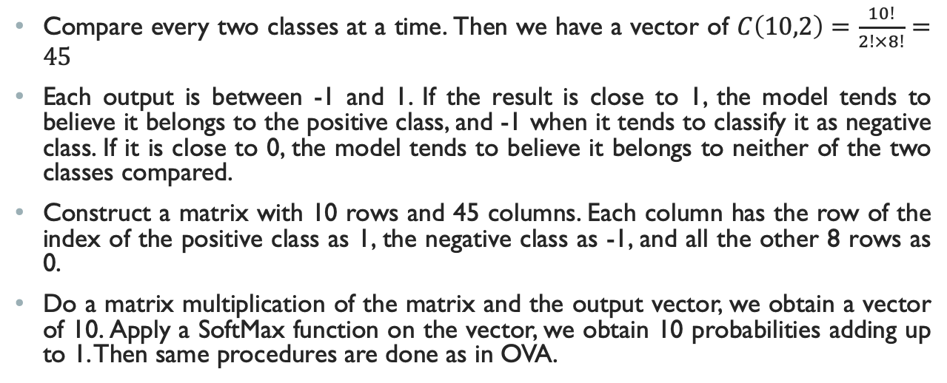
One versus one (OVO)
Compare every two classes at a time. Then we have a vector of $C\left(10,2\right)=\frac{10!}{2!×8!}=45$
Each output is between -1 and 1. If the result is close to 1, the model tends to believe it belongs to the positive class, and -1 when it tends to classify it as negative class. If it is close to 0, the model tends to believe it belongs to neither of the two classes compared.
Construct a matrix with 10 rows and 45 columns. Each column has the row of the index of the positive class as 1, the negative class as -1, and all the other 8 rows as 0.
Do a matrix multiplication of the matrix and the output vector, we obtain a vector of 10. Apply a SoftMax function on the vector, we obtain 10 probabilities adding up to 1. Then same procedures are done as in OVA.

Slide 4
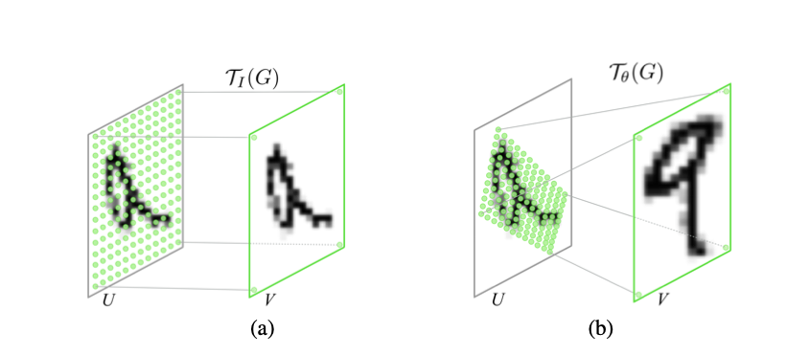
Spatial transformer networks (STN)
Localization network
train the transformer params
Parameterized sampling grid
transform each pixel of the image
Differentiable image sampling
transform the image
Combine the three above and insert to any CNN
In our experiment, we use the OVA ResNet18 after the STN.

Slide 5
optimizer
SGD (lr=0.001, decay_factor=0.1) no momentum

Slide 6
test RESULTS (782 of 3852 bad)
TPR/FPR (%) |  | OVA | OVO | STN
TPR>=99.1% | FPR | 5.83 | 5.37 | 12.28
TPR>=99.3% | FPR | 6.68 | 6.42 | 26.51
TPR>=99.5% | FPR | 7.08 | 13.76 | 37.59
TPR>=99.7% | FPR | 22.38 | 26.05 | 38.66
TPR=1 | FPR | 45.90 | 44.17 | 76.78
FPR<10.0% | TPR | 99.61 | 99.36 | 98.98

Slide 7
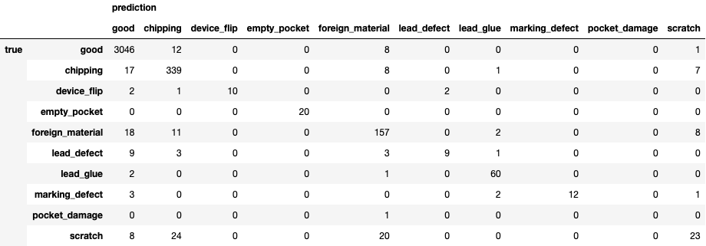
Confusion matrix (STN)

Slide 8
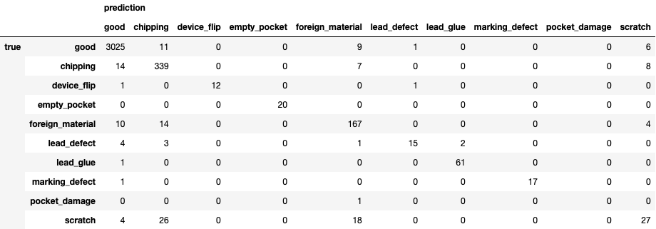
Confusion matrix (OVA)

Slide 9
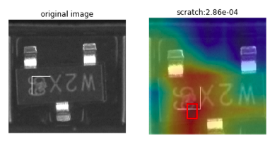
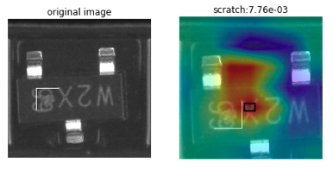
FALSE NEGATIVE
STN
OVA

Slide 10
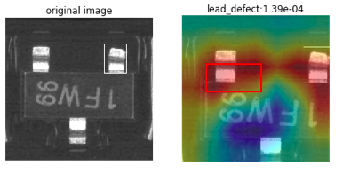
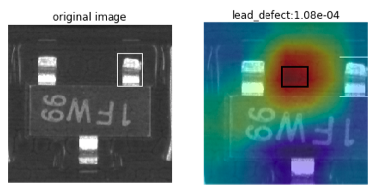
FALSE NEGATIVE
STN
OVA

Slide 11
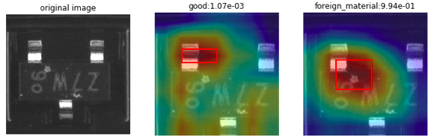
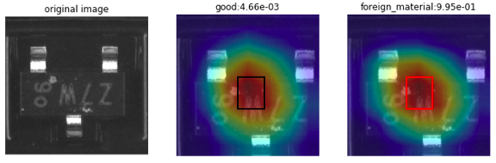
FALSE positive
STN
OVA

Slide 12
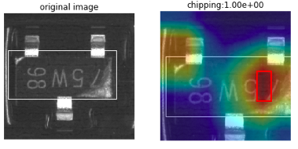
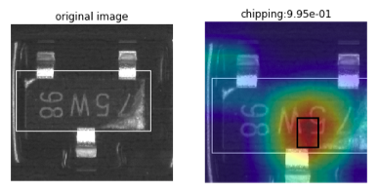
True positive
STN
OVA

Slide 13
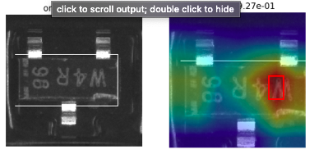
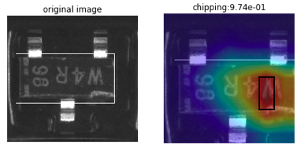
chipping
STN
OVA

Slide 14
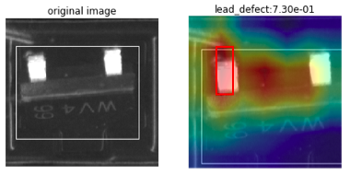
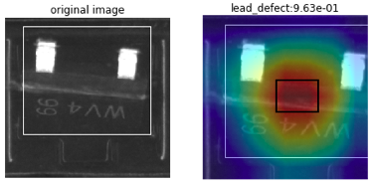
Lead_defect
STN
OVA

Slide 15
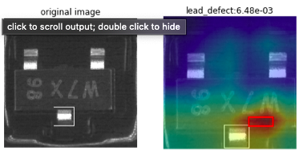
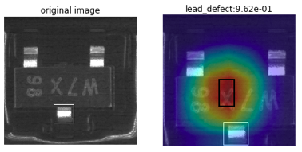
Lead defect
STN (FN)
OVA

Slide 16
Insights
STN does not outperform OVA or OVO when TPR>=99.1%,
But STN tends to pinpoint the defect areas more accurately.
Even if STN gives a wrong prediction, it’s heatmap makes sense indicating that either the label is wrong or that it does have some clue of the defect, though the clue is not evident enough for it to predict it as a defect, while OVA seems to predict in a more random way.
STN performs worst in detecting lead defect. Guess: lead defect does not differ much from a normal one after STN (warping)

Slide 17
Further investigation
Pinpoint defect areas (especially for lead defect) more accurately
Try to contain the transformer params within a certain range
Reexamine some data to see whether there are wrong labels
Object detection with bounding boxes (supervise the attention area)

Slide 18
references
Jaderberg, M., Simonyan, K., & Zisserman, A. (2015). Spatial transformer networks. In Advances in neural information processing systems (pp. 2017-2025).
Pawara, P., Okafor, E., Groefsema, M., He, S., Schomaker, L. R., & Wiering, M. A. (2020). One-vs-One Classification for Deep Neural Networks. Pattern Recognition, 107528.

